Slide 1
OFFICE OF REGULATORY STAFF
VC Summer Nuclear Project Review Committee
OCTOBER 25, 2017

Slide 2
PUBLIC INTEREST
Using and Consuming Public
Economic Development of SC… Jobs
Financial Integrity of Public Utilities

Slide 3
Utility Regulation in South Carolina prior to Passage of Act 175
Adjudicate
Educate
PSC
Investigate
Audit
Inspect
Examine

Slide 4
Utility Regulation in South Carolina after Passage of Act 175
Litigate
Adjudicate
Educate
Investigate
Audit
Inspect
Examine

Slide 5
Utility Regulation in South Carolina after Passage of Act 175
Litigate
Investigate
ORS
PSC
Educate
Inspect
Audit
Examine
Adjudicate

Slide 6
ORS Duties in Commission Cases
Party to all types of cases with 1 exception
Same Ex Parte Prohibitions as others
Same rights and restrictions as any party to cross examination
Makes recommendations thru testimony, reports and proposed orders
Appeals
Notes:
ORS, through testimony and proposed orders makes recommendations but PSC retains the sole authority to decide matters and adjust rates

Slide 7
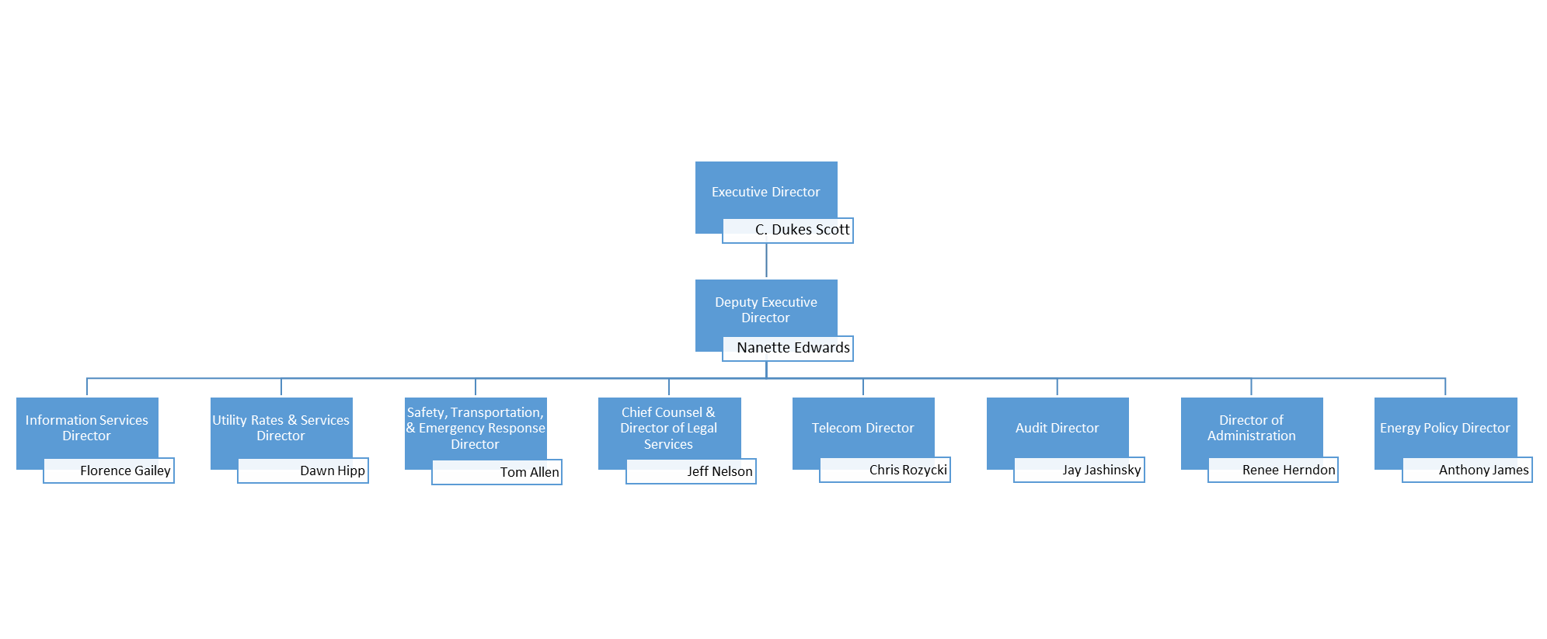
Organization Chart

Slide 8
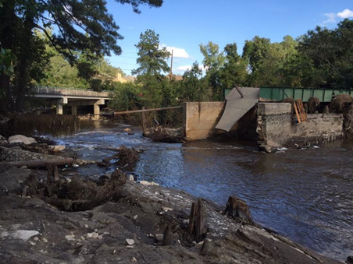
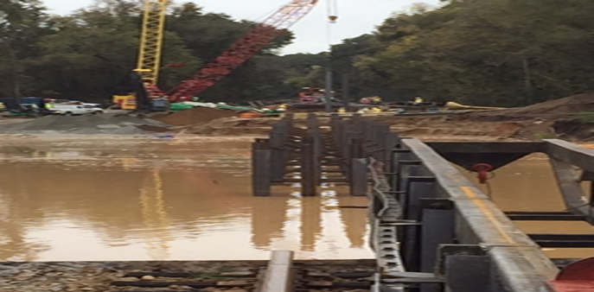
Safety, Transportation, Emergency Response
October 2015 Flooding and Hurricane Matthew
Notes:
Purpose during a Disaster in South Carolina:
Assess the extent of damage of energy systems and provide information to EMD and the Governor.
Coordinate, monitor, and report the restoration of energy systems
Coordinate consumer fuel/refueling operations during emergencies

Slide 9
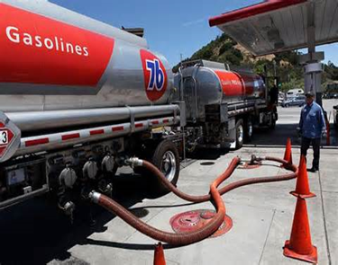
Fuel Plan
Build relationships with petroleum pipeline operators and distributors, and fuel stop owners
Identify evacuation and re-entry routes
Maintain supply at fuel stops along the routes

Slide 10
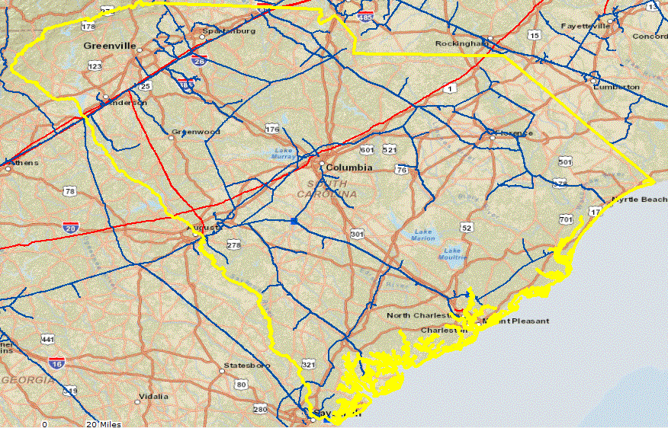
Safety: Natural Gas Pipelines
Distribution – 37,551
Transmission – 2,775
LNG facilities – 2
LNG tanks - 3
Progress Report Score: 48
Program Evaluation Score: 109
40,326 miles
Notes:
Progress Report—score was 48 out of 50. ORS lost two points for the state not adopting federal civil penalty amount ($100,000 per day with a maximum of $1,000,000). SC has currently has $10,000 per day and $500,000 maximum.
Program Evaluation—evaluates an agencies procedures, records, inspection activities and enforcement. ORS received 109 out of 110. ORS received a 1 point deduction for not using its fining authority.

Slide 11
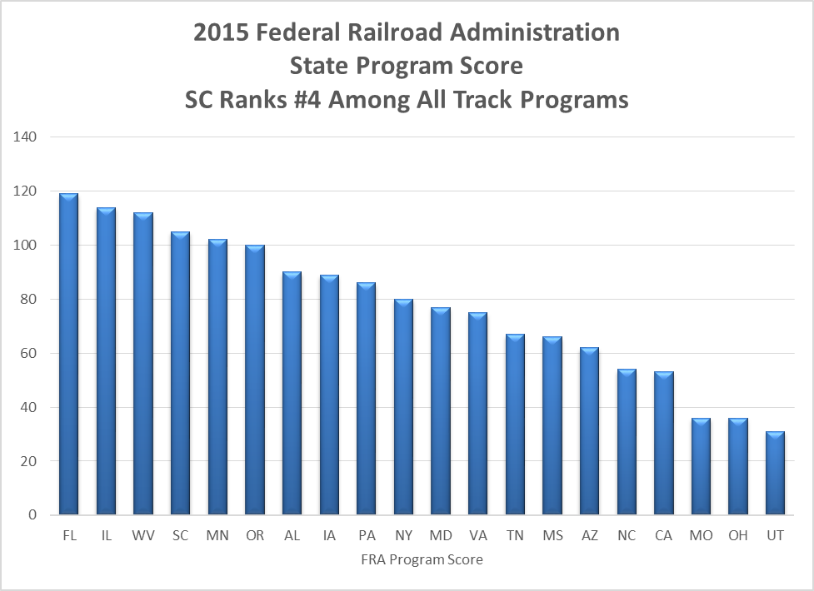
Notes:
Assisting Aiken Railway obtain a TIGER grant (U.S. Department of Transportation) to develop rural infrastructure.

Slide 12
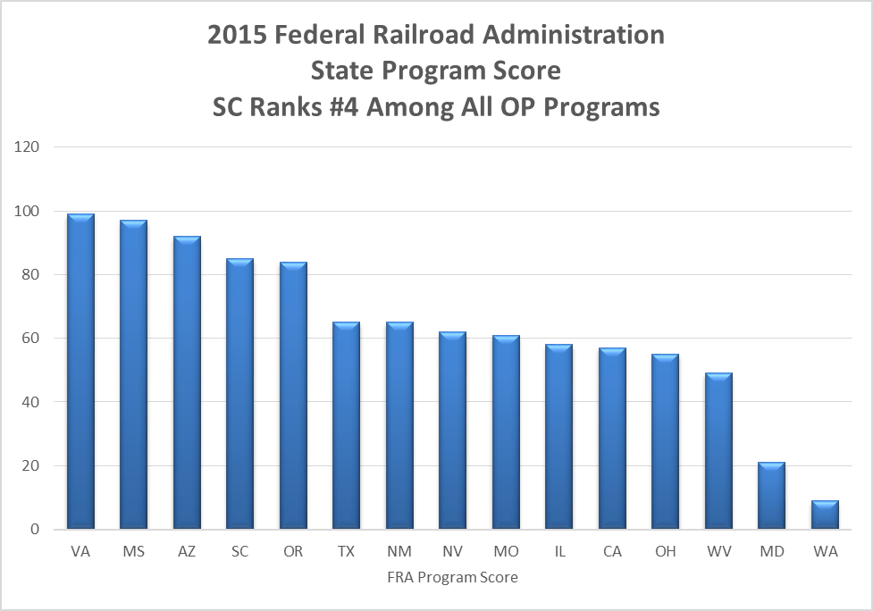

Slide 13
Transportation
Regulation of motor carriers of passengers, household goods, and hazardous waste for disposal
Monitoring carriers’ insurance, rates, charges, and practices
Household Good Carriers
Taxis
Charter Buses
Limousines
Non-emergency Transportation (NET)
Transportation Network Companies (TNCs)—Uber/Lyft

Slide 14
Energy Policy
Radioactive Waste Disposal Program
William States Lee III Nuclear Generating Station
VC Summer
Develop and Implement the State Energy Plan
Provide Technical Assistance
Provide Outreach/Education to Promote Energy Efficiency and Renewable Energy
Provide Financial Assistance
Promote Clean Transportation
Maintain Energy Data Clearinghouse

Slide 15
Energy Plan
Add Phase I II and III development slide
Notes:
Here is the layout of the energy plan development process. I will discuss details in the following slides. But here are the major components of the process:
Steering Committee
Phase I Work – Establish a baseline – to understand where we are today.
Public Engagement Sessions and Stakeholder Surveys used to supplement Phase I Work
Phase II – With reference to the baseline work - develop policy recommendations – Where do we go from here. Identified 8 Top Tier recommendations.
Steering Committee and Editorial Board step where we packaged the plan
And finally, the plan was presented to the PURC in April 2017. We received their support to continue our work on the Energy Plan.
Phase III - We are now in Phase III now and have assembled 8 study committees to address each of the Top Tier recommendations
IRP Planning Process – Update our current process
NG Infrastructure – How to expand NG service
Energy Codes – Should SC automatically adopt updates
Financing – How to find funds for energy upgrades
Act 236 2.0 – What’s next for renewables in SC
Environmental Equity – Economic development and the fair treatment of vulnerable communities
Clean transportation – expand clean transportation in state fleets
Energy Audit – How to streamline the process for state agencies that want to perform energy audits

Slide 16
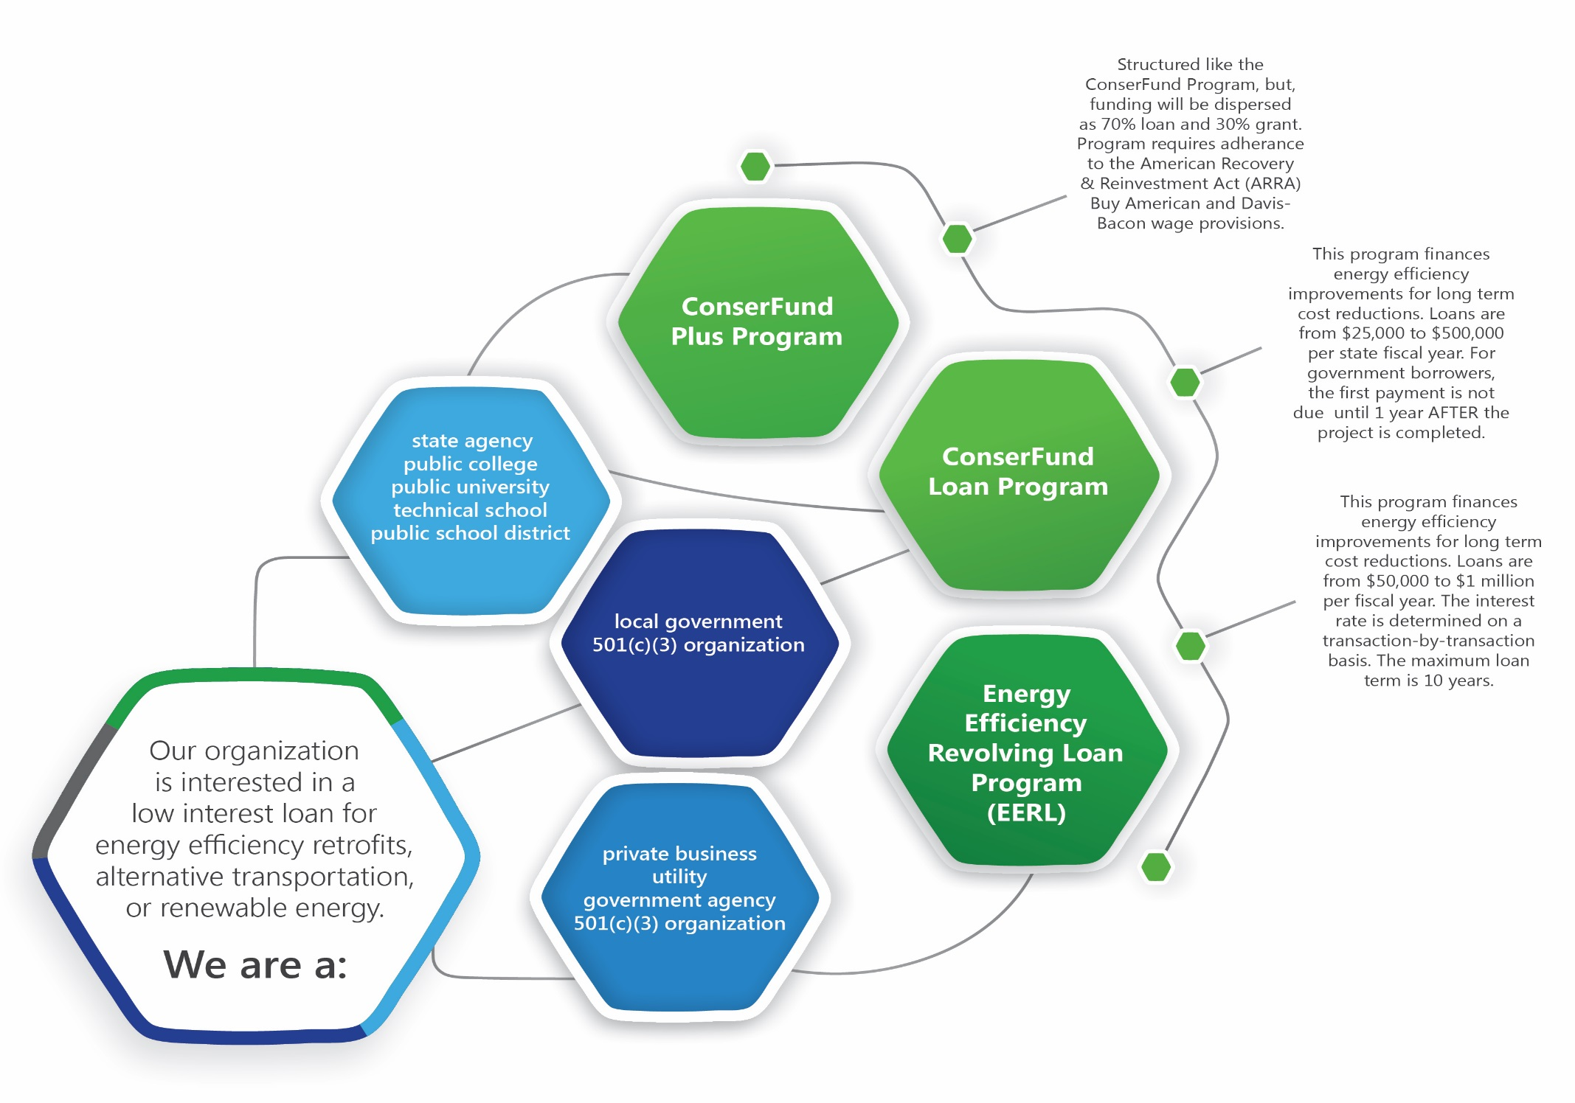
Financial Assistance

Slide 17
Dual Party Relay Fund
Telecommunications
Relay Service
SC Equipment Distribution Program
Closed Captioning of the General Assembly
Real-time Closed Captioning of Local News Broadcasts
Don’t just amplify your conversation.
phones and alerting devices to enhance hearing and speech.
Notes:
SC State USF

Slide 18
Audit
Audits books and records of regulated utilities
Examines all rate impacting filings and provides testimony
Examines costs for low level radioactive waste disposal facility in Barnwell, SC
Audits compliance with regulatory fees (Dual Party, USF)
Conducts financial compliance reviews of grantees in support of Energy Office

Slide 19
Utility Rates and Services
Electric:
Investor-owned electric utilities in S.C.
Act 236/Leasing
DSM/EE
Utility facility siting of transmission and generation facilities by any entity in S.C. – excluding Santee Cooper
No authority over the activities of Santee Cooper
Territorial disputes
Gas:
Investor-owned natural gas utilities in S.C.
With the exception of natural gas pipeline safety, no authority for non-jurisdictional utilities including municipal systems, natural gas authorities, and liquid propane systems
Water/Wastewater:
Privately owned water and wastewater utilities in S.C.
No regulatory authority over publicly owned providers of water and wastewater services -- counties, water and sewer districts, municipalities
No regulatory authority over self-serving systems – i.e. member-owned cooperatives

Slide 20
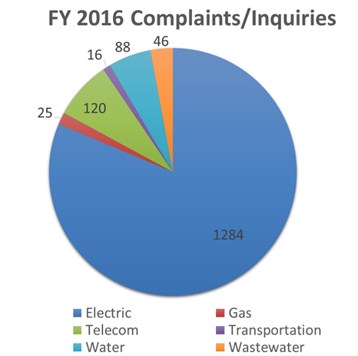
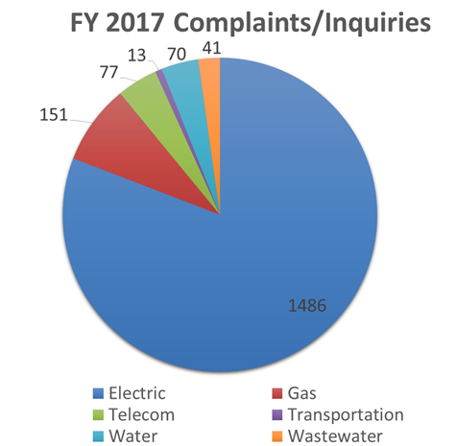
Consumer Services

Slide 21
THANK YOU!

